Slide 1
Adaptable Opportunity Analysis
Isaiah Sarria, Rishi Bhakta, Simon Pringle, Randy Koliha

Slide 2
Introduction
When given multiple job opportunities, which one is the right one to pick objectively?
Do you have any preferences?
How impactful is a hybrid opportunity?
If an internship is accepted, does it make sense to make it my full-time job?

Slide 3
Objective
The objective of the models is to find what job is the best fit for a student to pick with certain personal parameters and constraints.
The internship, full time, and hybrid models show us what job we would like to pick based on commuting, subjective preferences, and maximum pay.
The job satisfaction model uses Glass Door ratings of certain attributes and preferences of these parameters and gives a score to each job.

Slide 4
Methodology
Create a job scoring model
Create a list of important traits of a job that is important to you
Rank the company based on available information
Assign weight to each attribute based on what is important to you
Use it for a constraint later
Create a 0-1 Integer Model based on internships salaries
Consider your personal constraints, e.g at least x pay and x job score
Create a 0-1 Integer model based on full-time job salaries
Create the previous model that addresses weekly work-from-home days if any

Slide 5
Assumptions and General Features
Our vehicle's fuel efficiency is 32 mpg and holds 12 gallons in the tank
Gas costs $3.56 per gallon
Our origin is using Floria Polytechnic's address
The estimated time it takes is to reach location in minutes was based off Google maps at the time of 7:32p on 4/17/23
Some internship salaries are known from peers, but all other salaries and most job scores are all arbitrary
The models operate in three-month intervals.

Slide 6
Requirements
Less than or equal to a roundtrip of 3000 miles
Less than or equal to spending 3000 minutes driving throughout 3 months
Less than or equal to spending $400 on gas throughout the 3 months
Less than or equal to spending $2000 of an opportunity cost throughout the 3 months
Greater than or equal to an overall job preference score of 5.5
Greater than or equal to an earnings profit of either $5500 or $18000 after subtracting costs

Slide 7

Job Scoring Model: Purpose
The goal of the scoring model is to accurately consider the qualitative data and preferences that are important to each workplace choice
The end score is a combination of how well each company performs in each additional category besides pay
The end score for each company will be considered as a factor in the constraints of our 0-1 Integer Models

Slide 8
Scoring Variables
Culture: Work environment, how employees are treated and how they interact with other coworkers and supervisors
Glassdoor rating: The overall score of all the companies as listed in Glassdoor, a website where employees rate companies based on how good of a company it is to work for. They are out of 5, so we multiplied the rating by 2 to make it out of 10 to be on the same scale of other scores.
Benefits: Includes health, financial, and vacation benefits among others and gives a rating based on how many benefits are include and the quality in which they are at. This is benefits rating as per Glassdoor.
Hybrid: For everyday a job is available to be worked remote in a work week, this score goes up by two.
Generosity: How often the company buys their employees gifts, company branded merchandize, and food
Amenities: Includes the quality-of-life implementations the building has as such as gym, showers, vending machines, on site fresh catering, walking trail, etc.
Location: Considers if the building itself is nice, new, and is located somewhere with a nice view or is conveniently located to other businesses whether by car or walking distance. An unkempt building in the middle of nowhere or in a bad neighborhood would have a bad score.
Workload: A measurement of stress, workload, and means to reduce them. The higher this rating, the less stress there is.

Slide 9
Job Scoring Model
Jobs | Culture | Glassdoor Ratings | Benefits | Hybrid | Generosity | Amenities | Location | Stress Aversion
Publix | 8 | 7.6 | 8 | 4 | 8 | 6 | 6 | 6
Badcock | 8 | 7 | 5.6 | 4 | 5 | 2 | 7 | 8
NFI | 5 | 6.8 | 5.2 | 0 | 4 | 1 | 4 | 9
Universal | 6 | 8 | 8 | 0 | 3 | 5 | 9 | 5
Disney | 9 | 7.8 | 8.2 | 6 | 9 | 3 | 9 | 3
Masonite | 5 | 7 | 7.4 | 4 | 6 | 5 | 8 | 7
Coca Cola | 3 | 6.8 | 7.4 | 0 | 2 | 5 | 6 | 6
Saddle Creek | 9 | 7.6 | 6.2 | 8 | 8 | 3 | 4 | 6

Slide 10
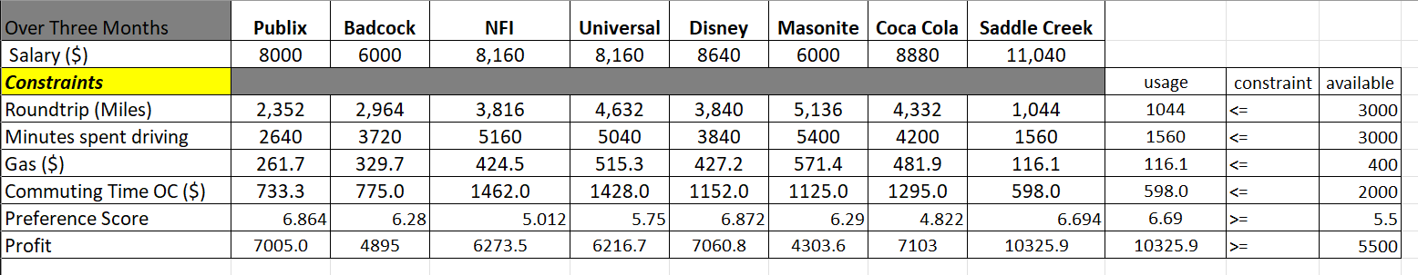
Internship 0-1 Integer Model
6.864
6.28
5.012
5.75
6.872
6.29
4.822
6.694
6.69

Slide 11
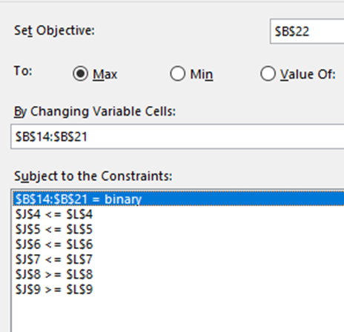
Optimal solution & Solver

Slide 12
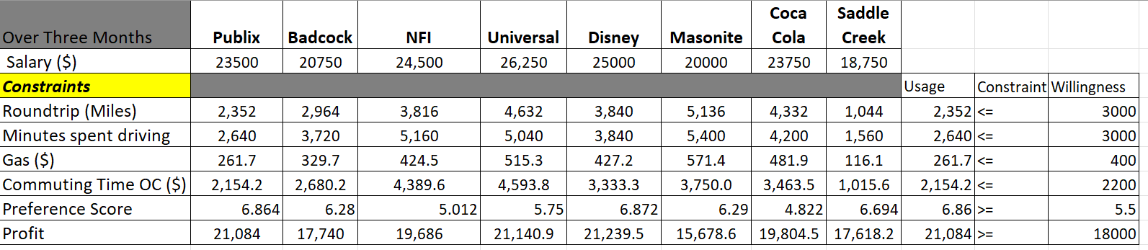
Full-Time Variation
6.864
6.28
5.012
5.75
6.872
6.29
4.822
6.694
6.69
*We now accept an increase of 200 in OC

Slide 13
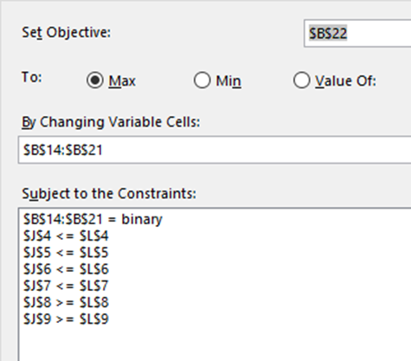
Optimal Solution & Solver

Slide 14
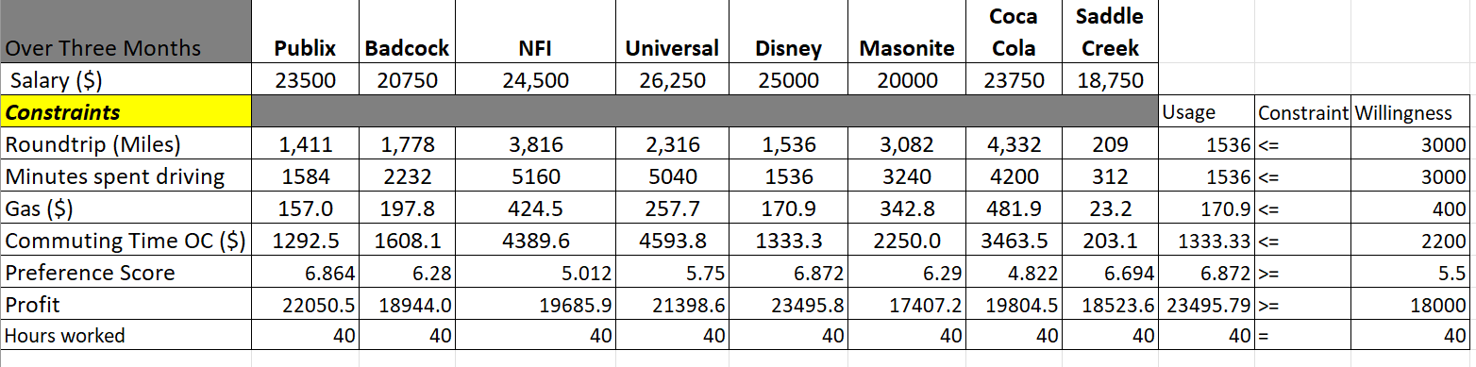
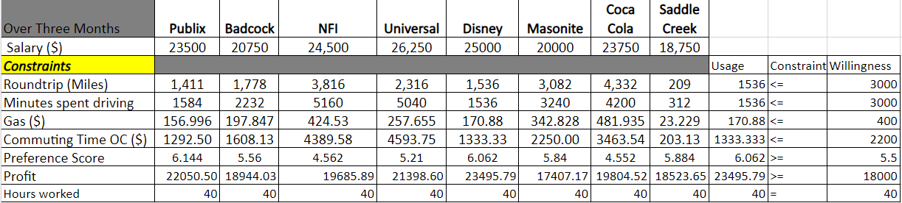
Full-Time Hybrid Variation

Slide 15
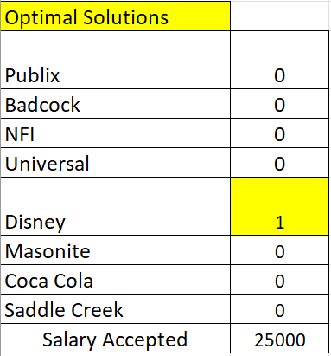
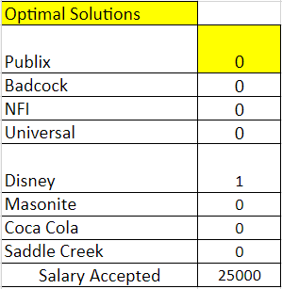
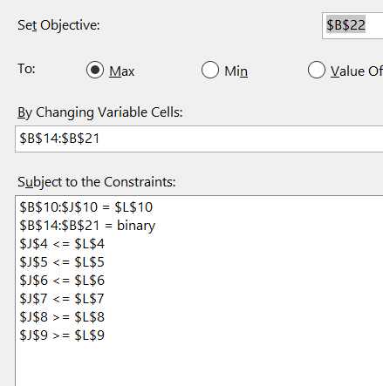
Optimal solution & Solver

Slide 16
Results
Saddle Creek is the best solution for internship, so the focus should be on that opportunity for the short term.
For a career, Publix should be selected as a long-term Full-Time position if there is no hybrid for all jobs
When WFH days are factored in, Disney is the best long-term opportunity
When just considering scores, Publix was also the preferred choice.

Slide 17
Conclusion
We created a model that considers different, important factors when selecting an opportunity
An additional factor to consider for future work is how cost of living in each area of the opportunity impacts the decision-making process?
Could it sometimes make more sense to commute a little bit longer or to move closer to your job?

Slide 18

Thank you!
Formulas:
Roundtrip = distance * 2 (there and back) * 60 (working days over three months)
Minutes spent driving = minutes * 2 (there and back) * 60 (working days over three months)
Gas $ = Roundtrip / 32(mpg) *3.52(avg gas price)
Opportunity Cost (OC)= (minutes driving/60 minutes) * ((three-month salary/60 working days)/8 hours
Profit = Salary Pay - (OC + Gas $)

